Slide 1


A Two-Stage Semi-Supervised nnU-Net Model for Automated Tooth Segmentation in Panoramic X-ray Images
MICCAI STS 2024 Challenge Task 1
Team: SJTU_EIEE_2-426Lab
Presenter: Chuanyi Huang
covering joint work with:
Changkai Ji¹, Yusheng Liu¹, Lanshen He¹, Yuxian Jiang¹, Chuanyi Huang¹, and Lisheng Wang^{1*}
¹Department of Automation, Shanghai Jiao Tong University, Shanghai, China.

Slide 2
Outline
Introduction
Contributions
We designed a self-training framework based on nnU-Net, enhancing model performance through selective iterative training.
Our algorithm improves segmentation accuracy while maintaining inference efficiency, striving for an optimal balance between precision and performance.
At the competition's test phase, our method secured third place, further demonstrating its efficacy in dental segmentation tasks.
Results

Slide 3
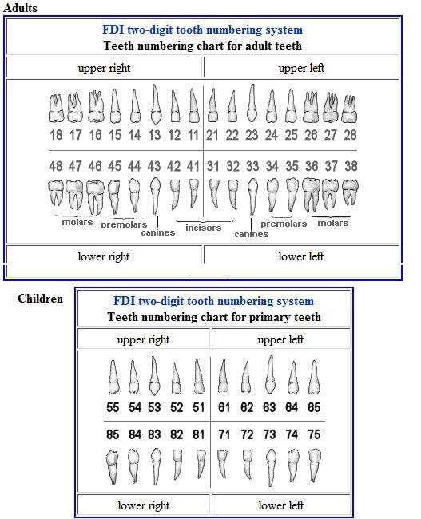
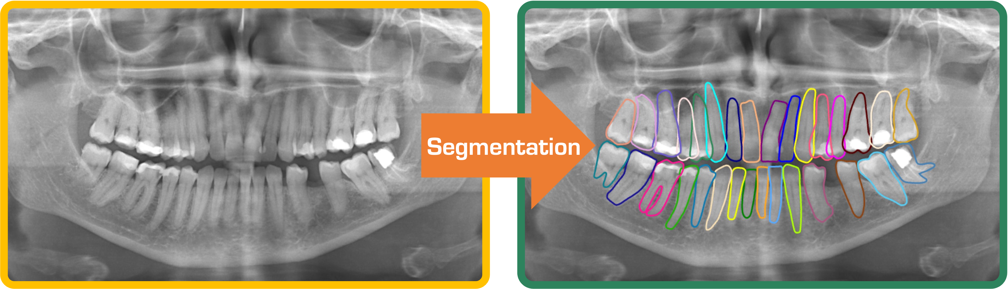
Introduction
Panoramic X-rays are crucial in dental diagnosis, but manual segmentation is time-consuming and operator-dependent.
Develop an automated tooth segmentation method to improve efficiency and consistency.
Simultaneous segmentation of permanent and deciduous teeth, balancing accuracy and computational efficiency.
[1] Kılıc, Münevver Coruh, et al. "Artificial intelligence system for automatic deciduous tooth detection and numbering in panoramic radiographs." Dentomaxillofacial Radiology 50.6 (2021): 20200172.

Slide 4
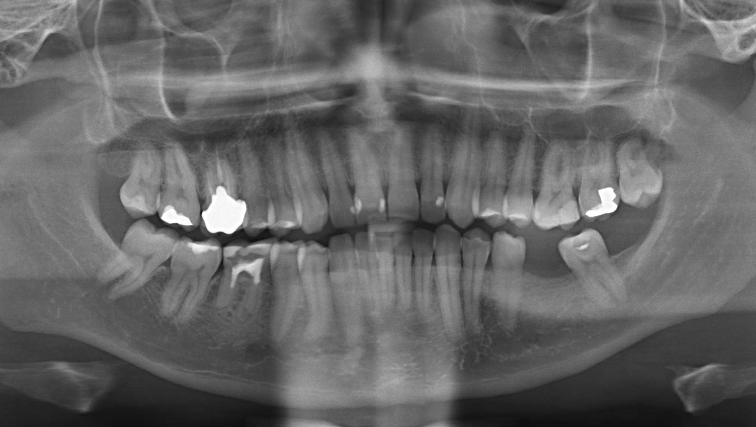
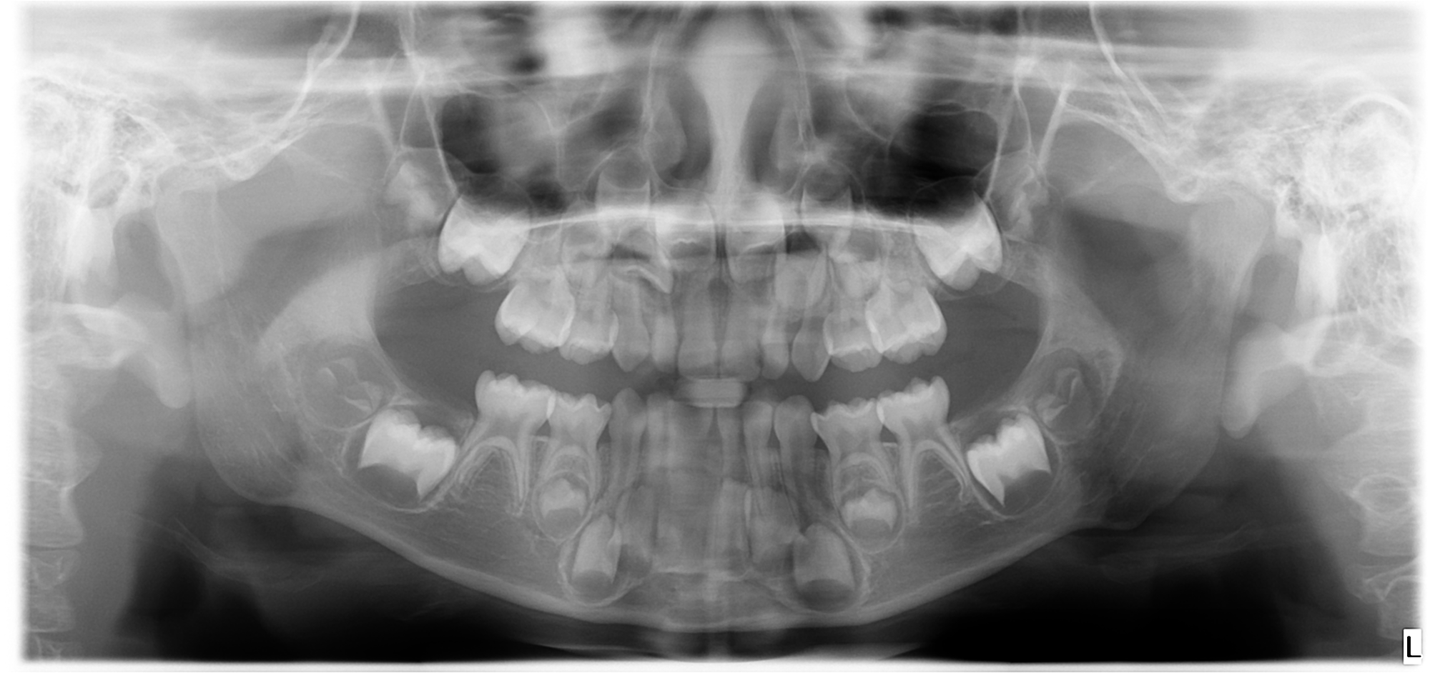
Dataset
Covers various age groups and pathological effects
Training Set: 2,380 Panoramic X-ray Images (30 labeled; 2,350 unlabeled)
Validation Set: 20 Panoramic X-ray Images
Permanent teeth
Deciduous teeth

Slide 5
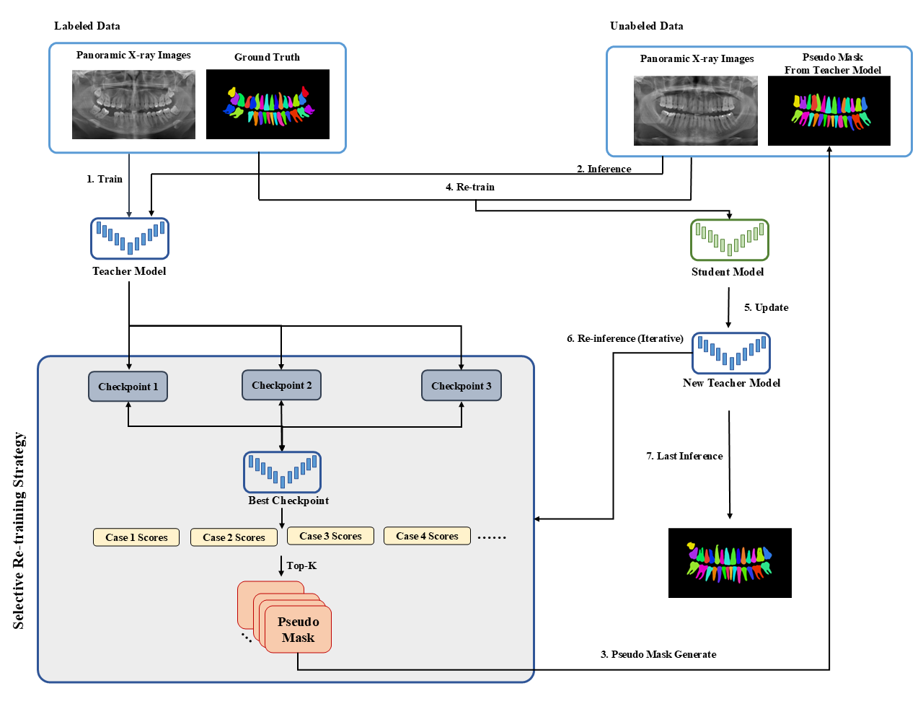
Methods
We transform the challenging task into a semi-supervised task. In each iteration, the student model is promoted to become the new teacher model.

Slide 6
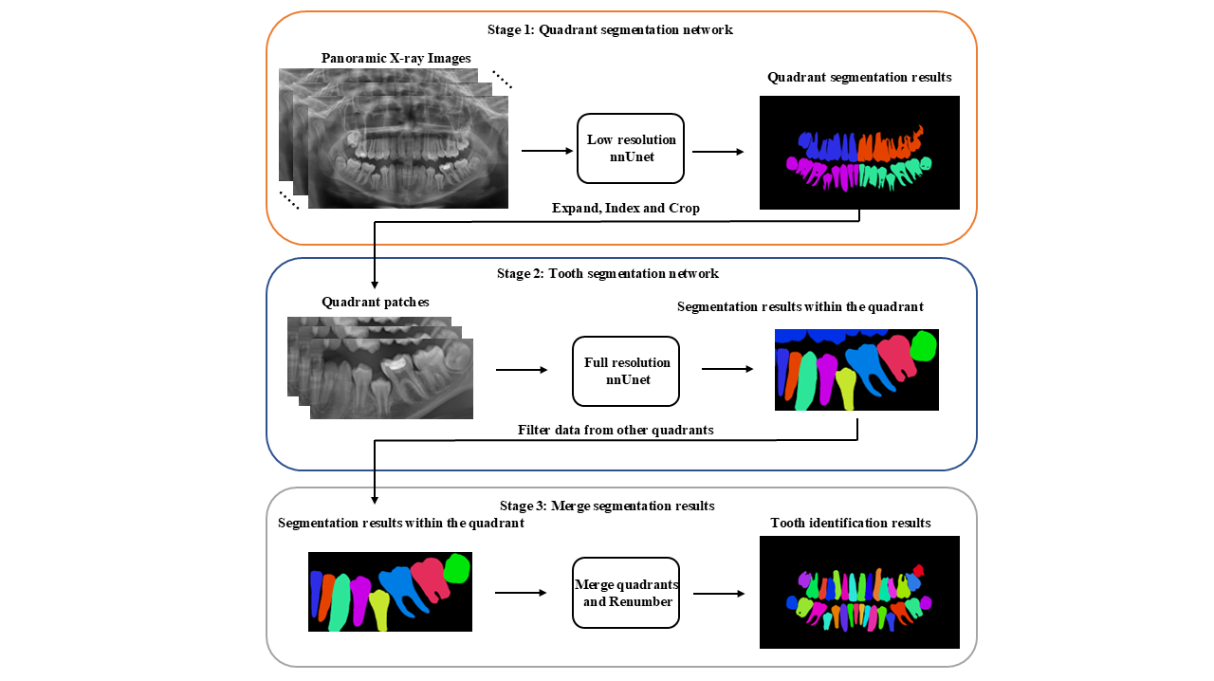
Model Training
Stage 1: nnU-Net segments the input dental panoramic image into four categories, identifying the four dental quadrants.
Stage 2: Based on the first stage results, teeth in each quadrant undergo fine segmentation. A 14-class nnU-Net segmentation model is applied, including eight classes of permanent teeth, five classes of deciduous teeth, and one class for teeth in other quadrants.
Stage 3: Segmentation results from all four quadrants are combined to produce a comprehensive teeth segmentation map.
Post-posing: Following each segmentation stage, we employ a post-processing step to eliminate or merge small connected components with adjacent larger regions.

Slide 7
Selective re-training strategy
Three checkpoints are saved uniformly over 1/3, 2/3, 3/3 total iterations during training.
To ensure a balance between the permanent and deciduous tooth data, we regard the 101 permanent tooth images and 101 deciduous tooth images with mean Dice scores greater than 0.9 as reliable images, and the rest as unreliable images.

Slide 8
Results
Evaluation: segmentation accuracy and segmentation efficiency.
1) Segmentation accuracy: Dice similarity coefficient (DSC), normalized surface distance (NSD), mean Intersection-over-Union (mIoU), Identification Accuracy (IA).
2) Segmentation efficiency: GPU memory consumption (area under the GPU memory-time curve), running time (tolerance 45 seconds, single case maximum 60 seconds).
The ranking schema involves the following steps:
1) Compute two metrics, Dice and NSD, on a per-image basis to derive the algorithm's Dice (image_Dice) and NSD (image_NSD) scores at image-level.
2) Match the corresponding prediction results with the ground truth, allowing for the calculation of Dice (instance_Dice), NSD (instance_NSD), and IA (instance_IA) scores at the instance level.
3) Then, the evaluation will include measurements of running time and GPU consumption for each algorithm.
4) Take the mean of the eight metrics over the test cases, and rank separately among the teams.
5) A final overall rank is given by taking the average of the four ranks.

Slide 9
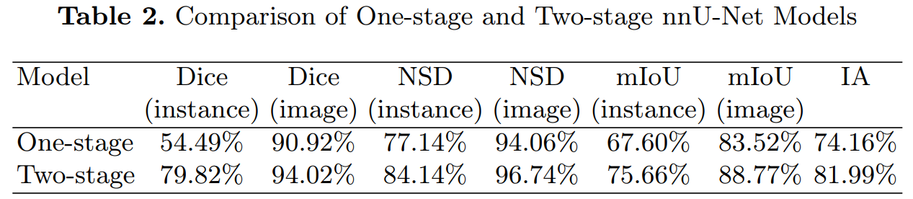
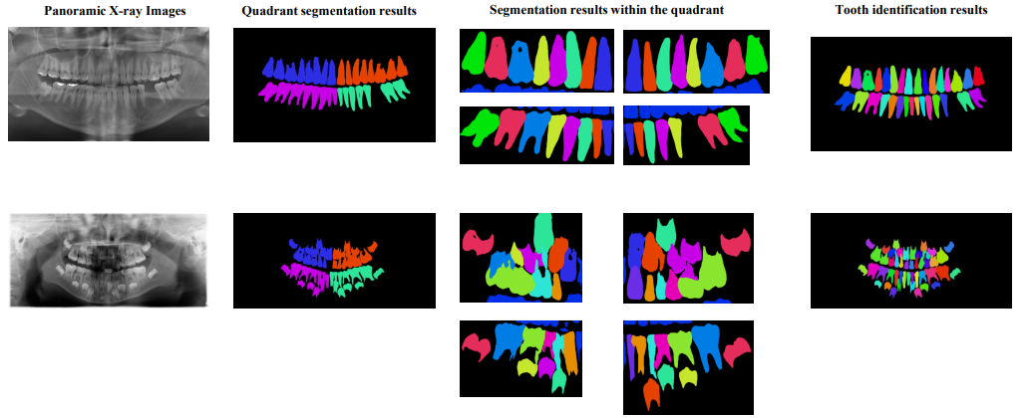
Results
The qualitative and quantitative results are shown as below.

Slide 10
Thank you for your attention!
changkaiji@sjtu.edu.cn

